Slide 2
Generations of Computer

Slide 3
First generation of computer
The beginning of commercial computer age is from UNIVAC (Universal Automatic Computer).
Scientists Mauchly and Echert at the Census Department of United State in 1947.
The first generation were used during 1942-1955.They were based on vacuum tubes.
Examples of first generation computer are UNIVAC and UNIVAC-1.

Slide 4
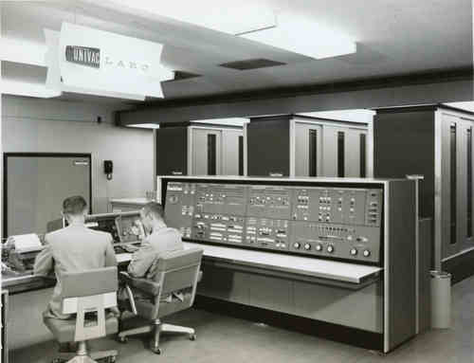

Slide 5
Advantages:
Vacuum tubes were the only electric component available during those days.
Vacuum tube technology made possible to make electric digital computers.
These computers could calculate data in millisecond.

Slide 6
Disadvantages:
The computers were very large in size.
They consumed a large amount of energy.
They heated very soon due to thousands of vacuum tubes.
They were not very reliable.
Air conditioning was required.
Constant maintenance was required.
Non-portable.
Costly commercial production.

Slide 7
Limited commercial use.
Very slow speed.
Limited programming capabilities.
Used machine language only.
Used magnetic drums which provide very less data storage.

Slide 8
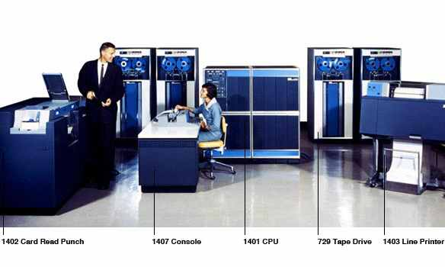
Second Generation of Computers (1955-1964)

Slide 9
The second generation computers used transistors. The scientists at Bell laboratories developed transistor in 1947. These scientists include John Barden, William Brattain and William Shockley. The size of the computers was decreased by replacing vacuum tubes with transistors. The examples of second generation computers are IBM 7094 series, IBM 1400 series and CDC 164 etc.

Slide 10
Advantages:
Smaller in size as compared to the first generation computers.
The 2nd generation Computers were more reliable
Used less energy and were not heated.
Wider commercial use
Better portability as compared to the first generation computers.
Better speed and could calculate data in microseconds
Used faster like tape drives, magnetic disks, printer etc.
Used Assembly language instead of Machine language.
Accuracy improved.

Slide 11
Disadvantages:
Cooling system was required
Constant maintenance was required
Commercial production was difficult
Only used for specific purposes
Costly and not versatile
Pooch cards were used for input.

Slide 12
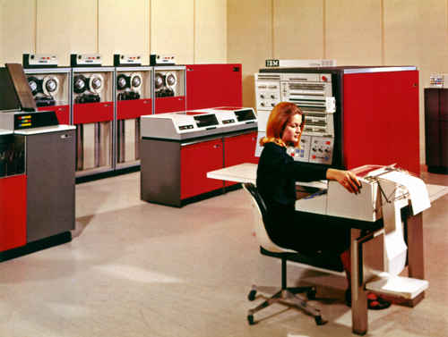
Third Generation of Computers (1964-1975)

Slide 13
The Third generation computers used the integrated circuits (IC). Jack Kilby developed the concept of integrated circuit in 1958. It was an important invention in the computer field. The first IC was invented and used in 1961. The size of an IC is about ¼ square inch. A single IC chip may contain thousands of transistors. The computer became smaller in size, faster, more reliable and less expensive. The examples of third generation computers are IBM 370, IBM System/360, UNIVAC 1108 and UNIVAC AC 9000 etc.

Slide 14
Advantage:
Smaller in size as compared to previous generations.
More reliable.
Used less energy
Produced less heat as compared to the previous two generations of computers.
Better speed and could calculate data in nanoseconds.
Used fan for heat discharge to prevent damage.
Maintenance cost was low because hardware failure is reare.

Slide 15
Disadvantages:
Air conditioning was required.
Highly sophisticated technology required for the manufacturing of IC chips.

Slide 16
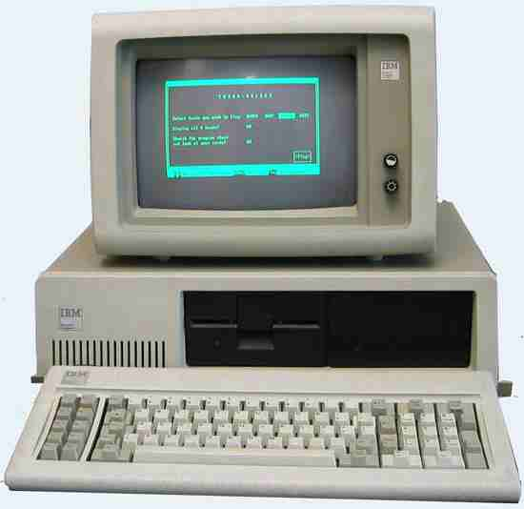
Fourth Generation of Computers (1975-Present)

Slide 17
The fourth generation computers started with the invention of Microprocessor. The Microprocessor contains thousands of ICs. Ted Hoff produced the first microprocessor in 1971 for Intel. It was known as Intel 4004. The technology of integrated circuits improved rapidly. The LSI (Large Scale Integration) circuit and VLSI (Very Large Scale Integration) circuit was designed. It greatly reduced the size of computer. The size of modern Microprocessors is usually one square inch. It can contain millions of electronic circuits. The examples of fourth generation computers are Apple Macintosh & IBM PC.

Slide 18
Advantages:
More powerful and reliable than previous generations.
Small in size
Fast processing power with less power consumption
Fan for heat discharging and thus to keep cold.
No air conditioning required.
Totally general purpose
Commercial production
Less need of repair.
Cheapest among all generations
All types of High level languages can be used in this type of computers

Slide 19
Disadvantage:
The latest technology is required for manufacturing of Microprocessors.

Slide 20
Fifth Generation of Computers (Present & Beyond)
Scientists are working hard on the 5th generation computers with quite a few breakthroughs.
It is based on the technique of Artificial Intelligence (AI). Computers can understand spoken words & imitate human reasoning. Can respond to its surroundings using different types of sensors. Scientists are constantly working to increase the processing power of computers. They are trying to create a computer with real IQ with the help of advanced programming and technologies.
IBM Watson computeris one example that outsmarts Harvard University Students. The advancement in modern technologies will revolutionize the computer in future.

